Slide 1


Slide 2
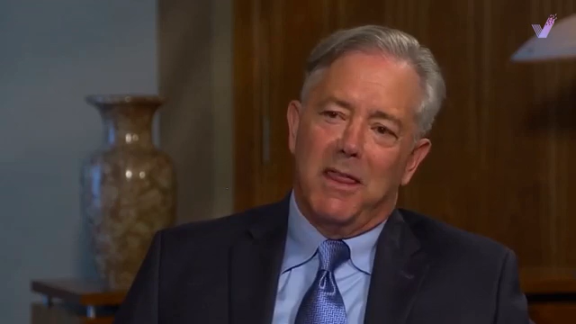

Slide 3


Slide 4
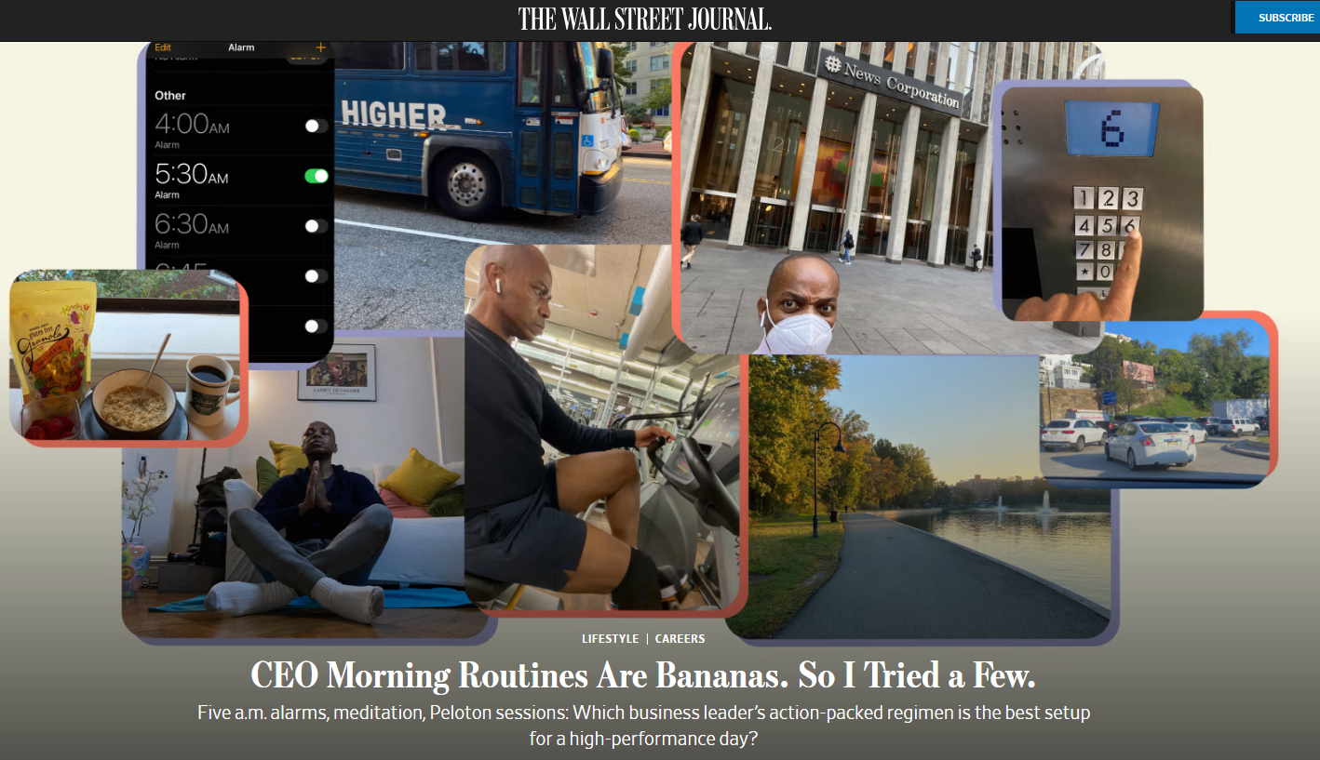


Slide 5
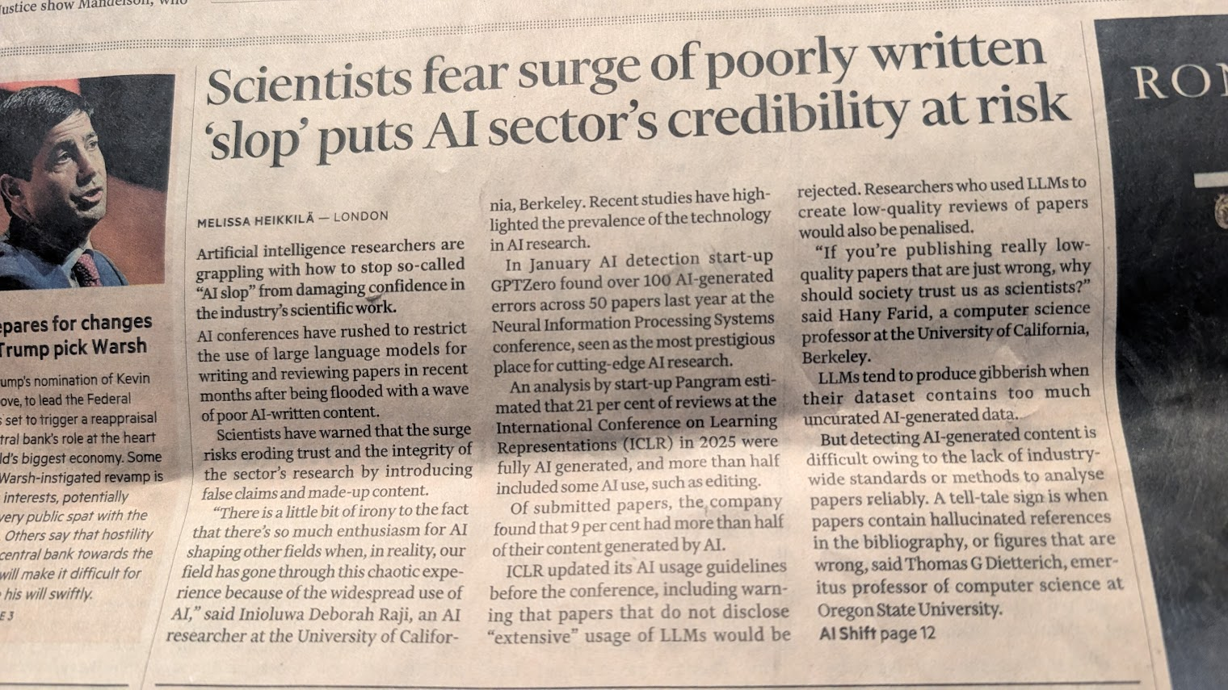
FT (1 February 2026)

Slide 6
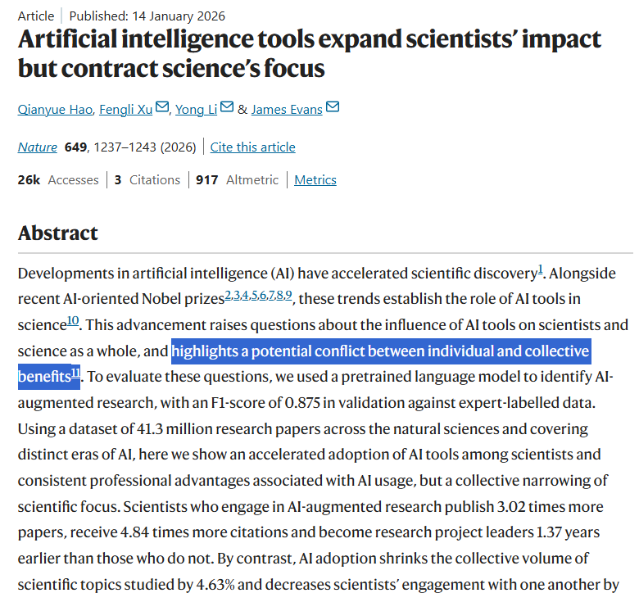
Nature (14 January 2026)

Slide 7
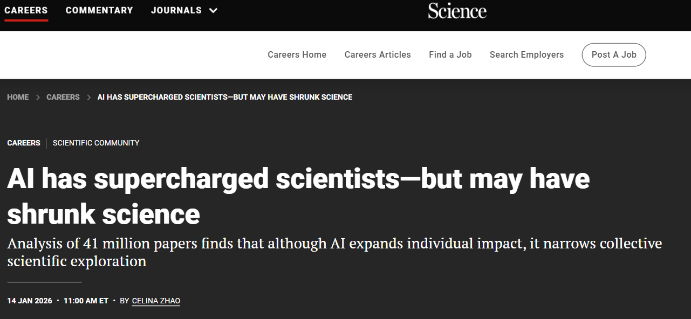
Nature (14 January 2026)
Science (14 January 2026)

Slide 8
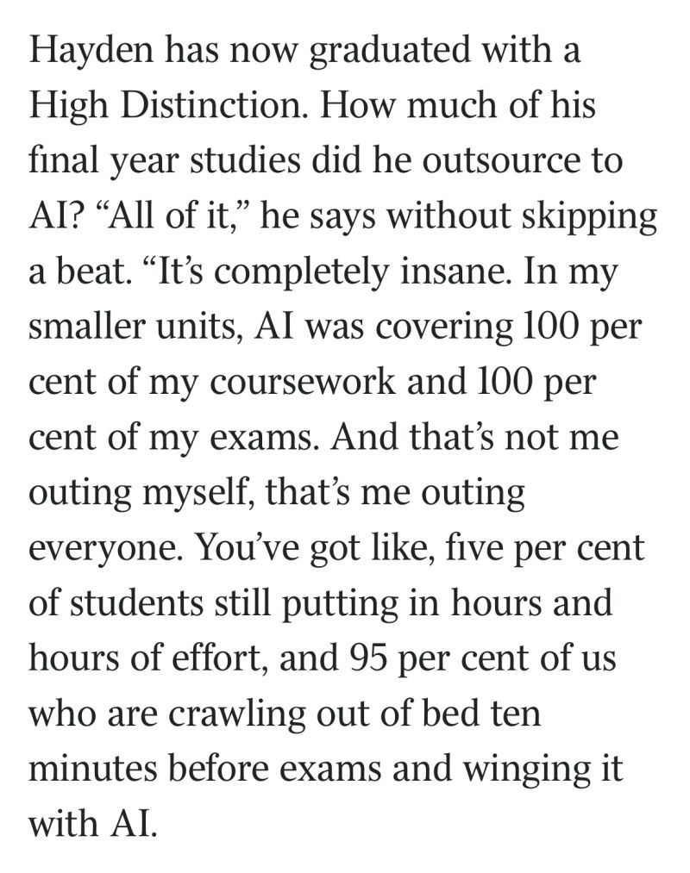
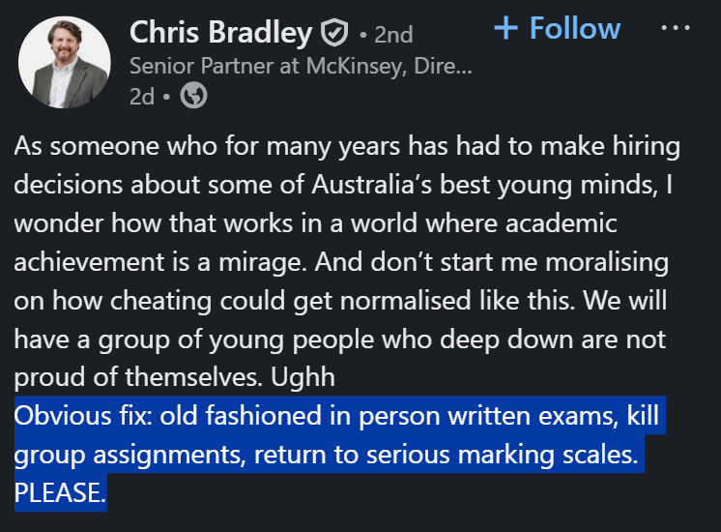
“Lobotomised by AI”, The Australian (6 Feb 2026)
LinkedIn (6 Feb 2026)

Slide 9
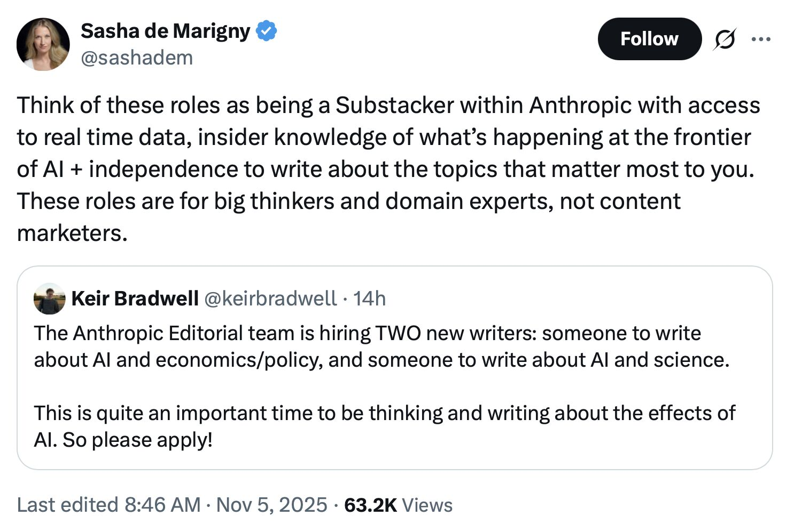

Slide 10


Slide 11
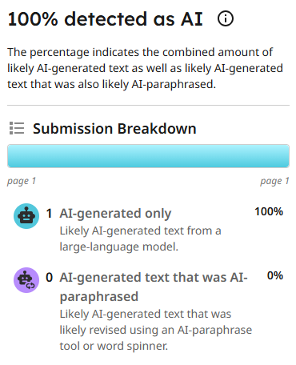
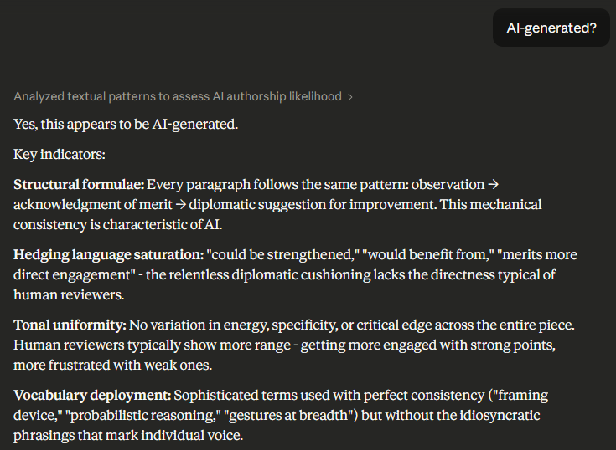
CourseWorks’ TurnitIn check
Same submission analyzed by Claude

Slide 12
The real answer must come via policy (duh!)
Meanwhile, we’re in a 1-to-2(?)-year period, where policies & norms have yet to catch up with technology…

Slide 13
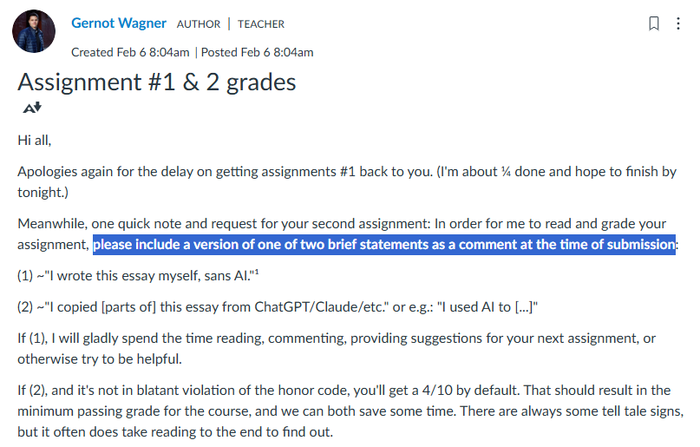

Slide 14
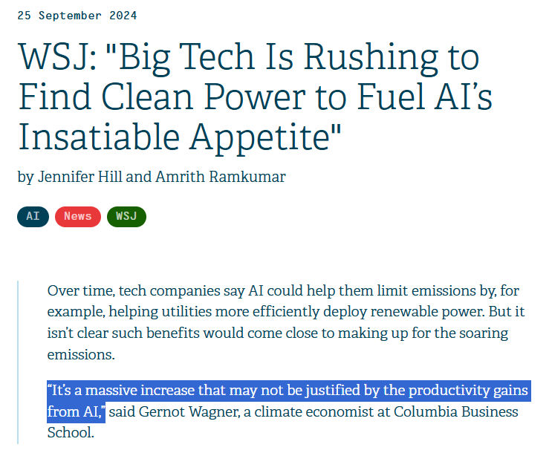
WSJ (25 September 2024)

Slide 15
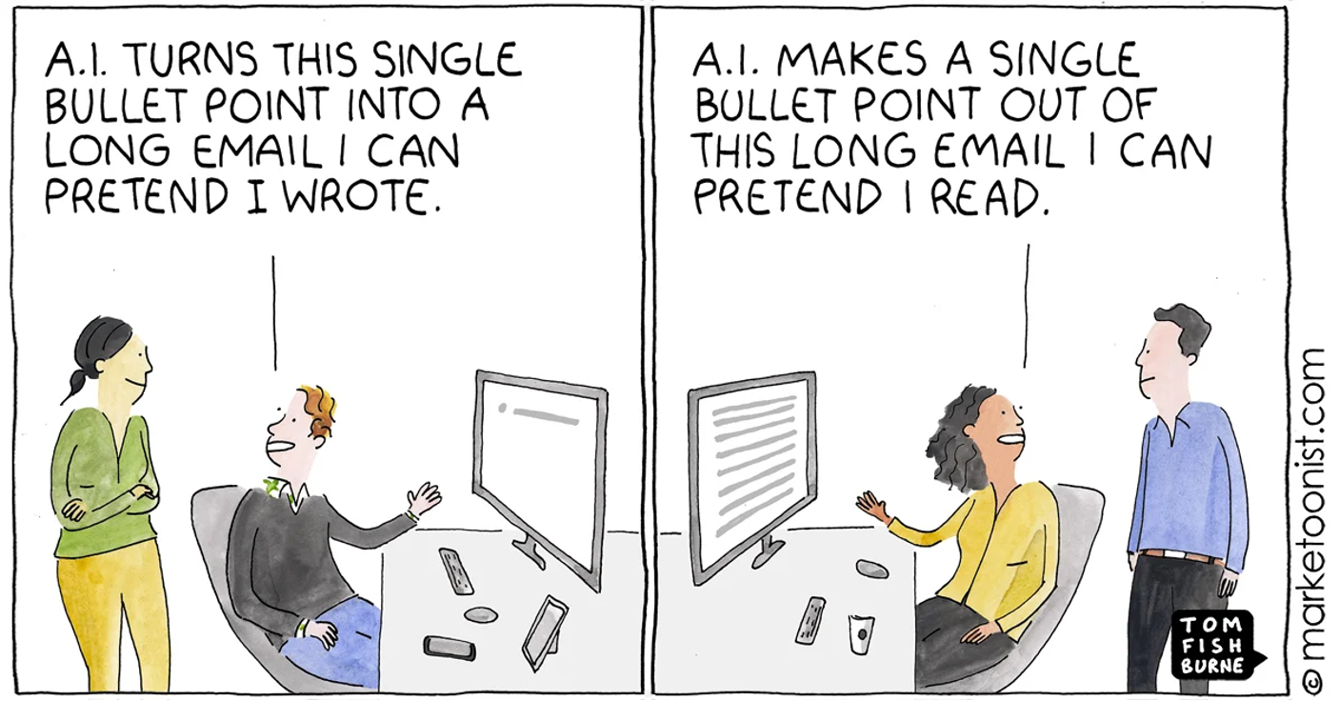

Slide 16
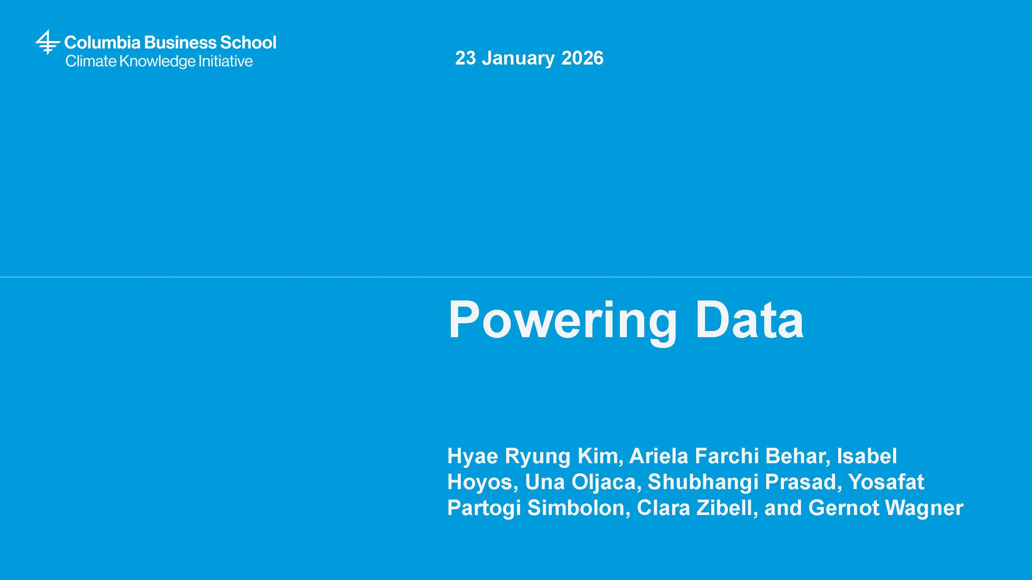
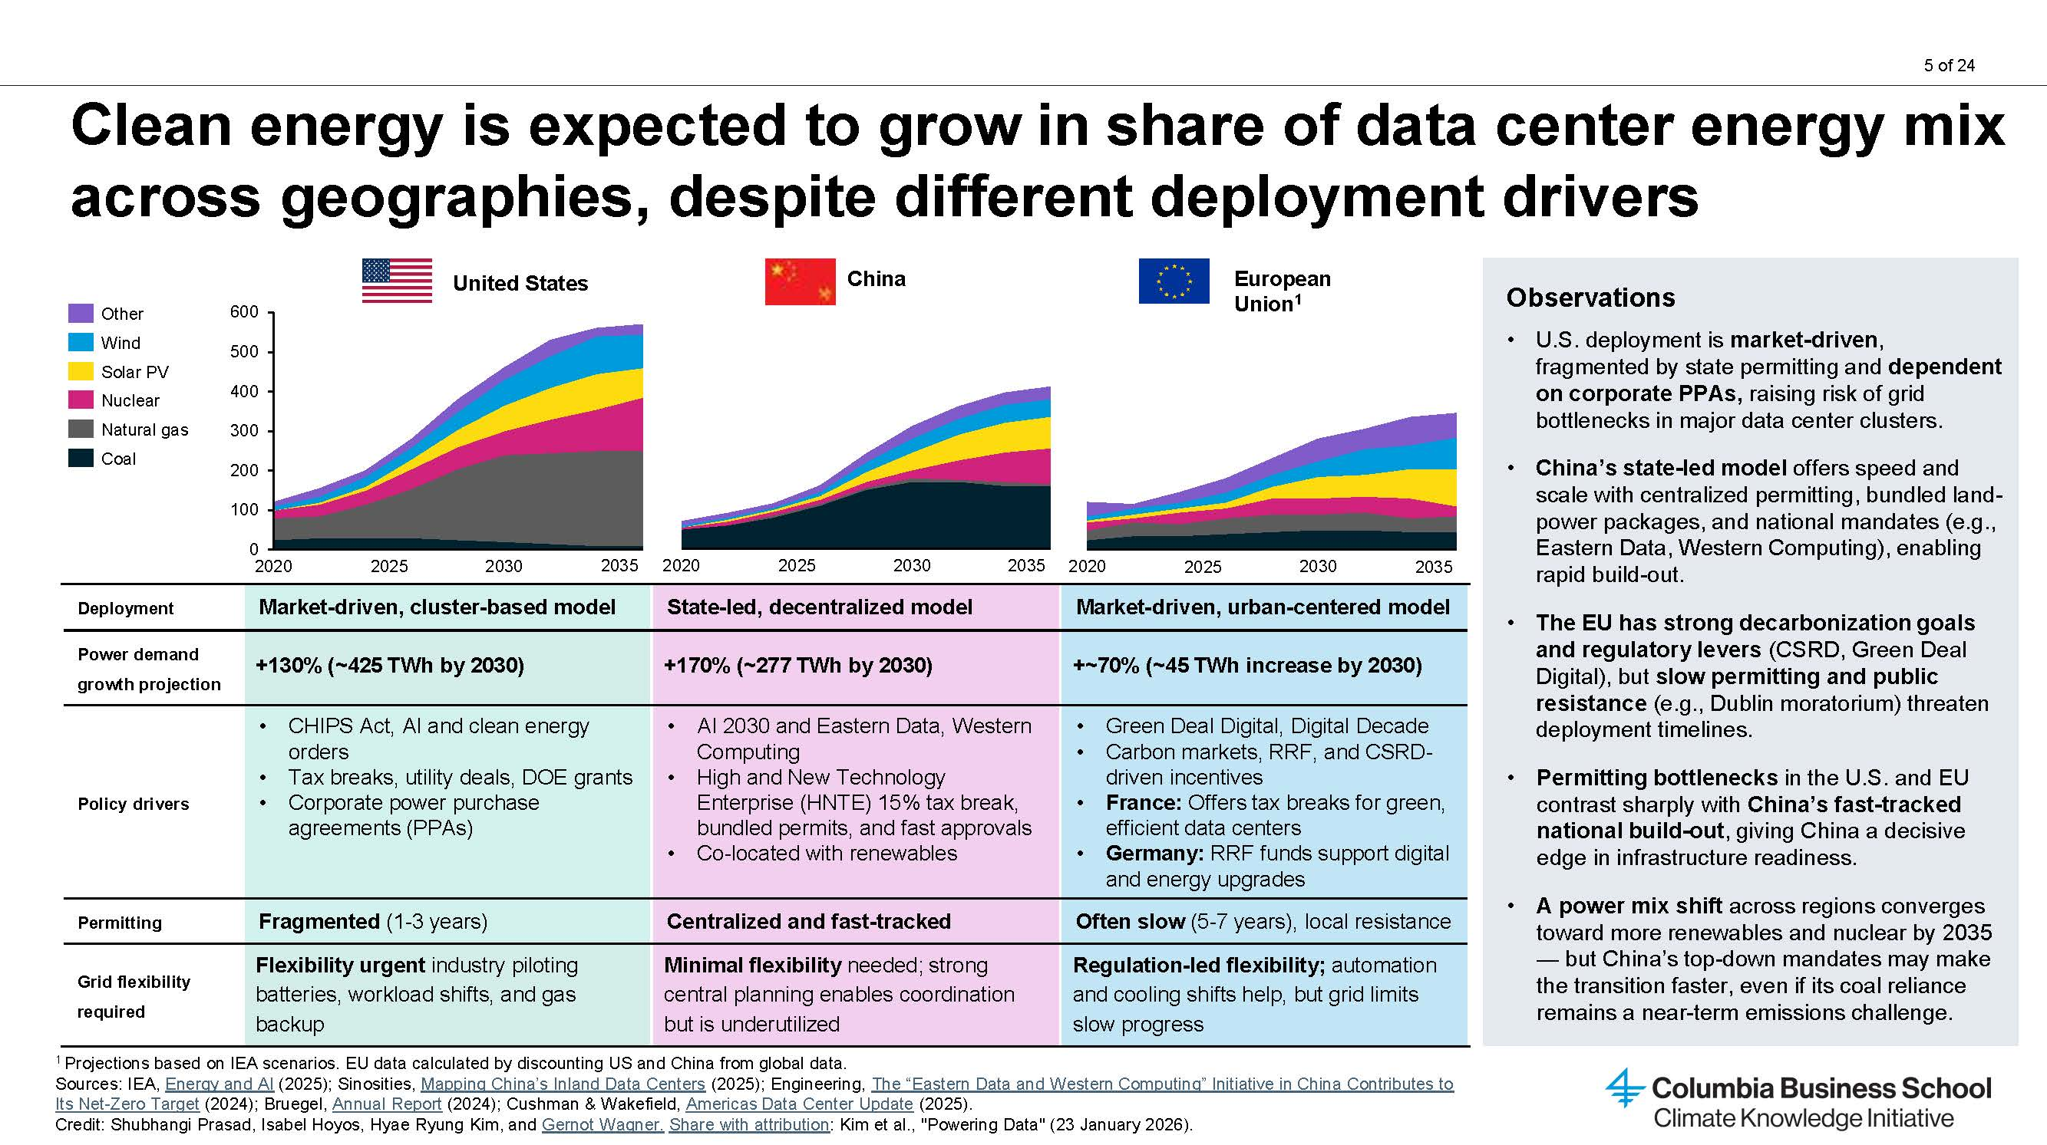
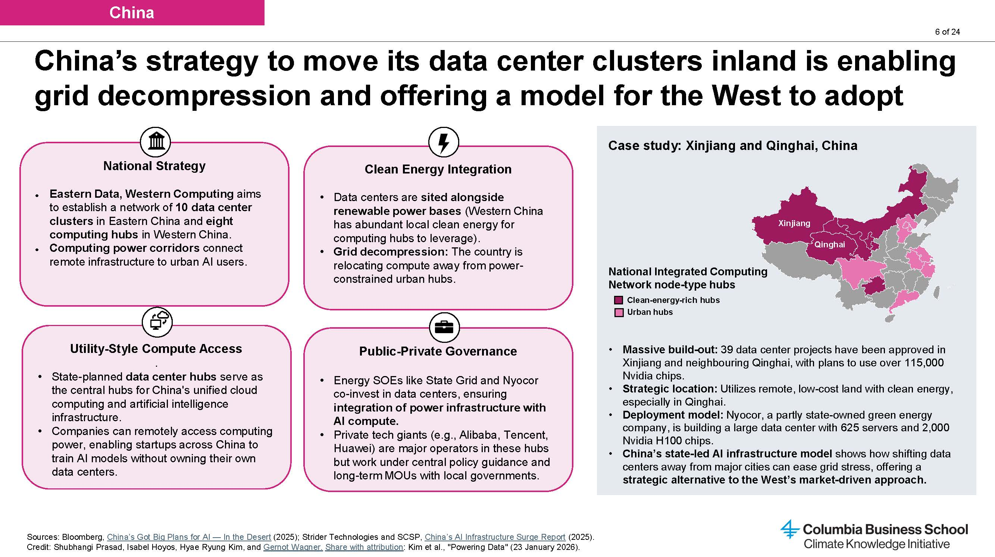
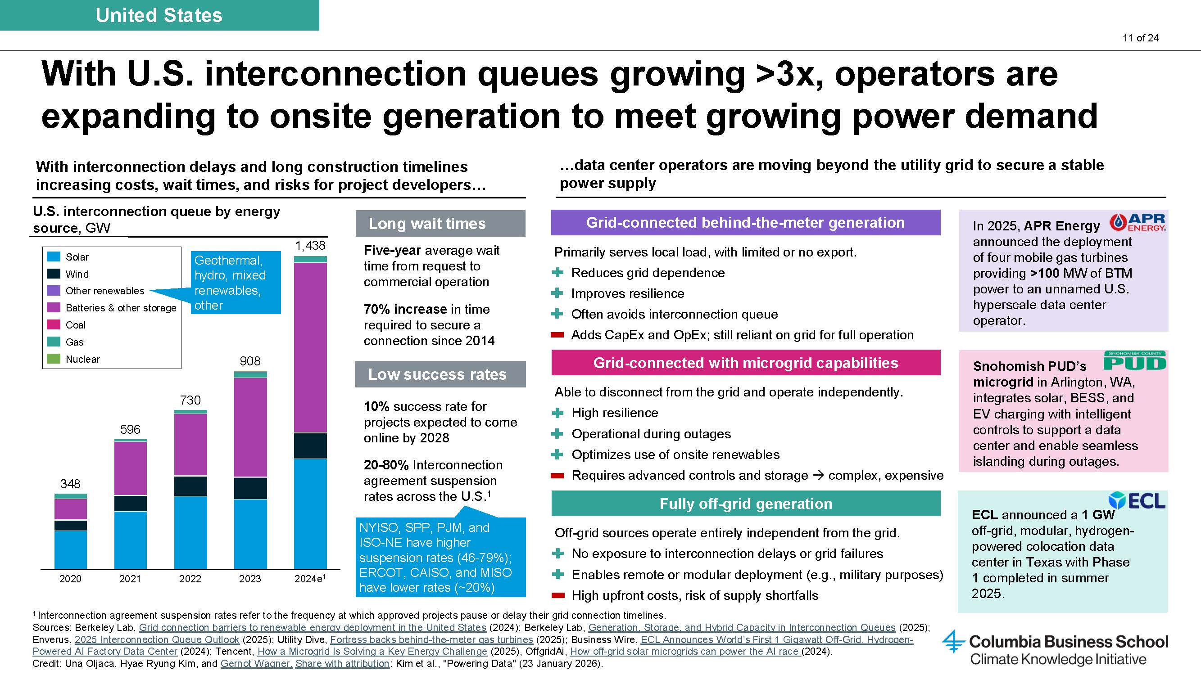
“Powering Data” (CKI, 23 January 2026)

